Slide 1



Slide 2
DEALING WITH UNCERTAINTY
SELF CARE
KINDNESS TO SELF
SELF AWARENESS
REFLECTION
LIMIT EXPOSURE TO NEWS / SOCIAL MEDIA
DEVELOP NEW SKILLS
Continue your healthy habits.
It’s okay to feel stress occasionally
Validating that you are uncomfortable and looking into what is the leading cause of this.
Think of Past Success
Limit screen time
What do I need to learn to make me feel more relaxed?

Slide 3

Networking
Is a business and social activity, that is completed both online and face to face. It is designed to create business relationships, create or act upon business opportunities and share information.

Slide 4

What do the statistics say?
85% of jobs are filled through networking
72% of people say their impressions are impacted by how someone appears and their handshake
1 in 4 don’t network at all
41% of networkers want to network more frequently but don’t have enough time
68% of entry-level professionals value face-to-face networking more than online
Only 11% of LinkedIn users have more than 100 people in their network
15 surprising stats on Networking and Face-to-Face Communication – Hub Spot Blog –Aja Frost - 2017

Slide 5

Personal Brand
Is the conscious effort to create and influence public perception of your ability, reputation and knowledge.

Slide 6

Let’s check in...

Slide 7
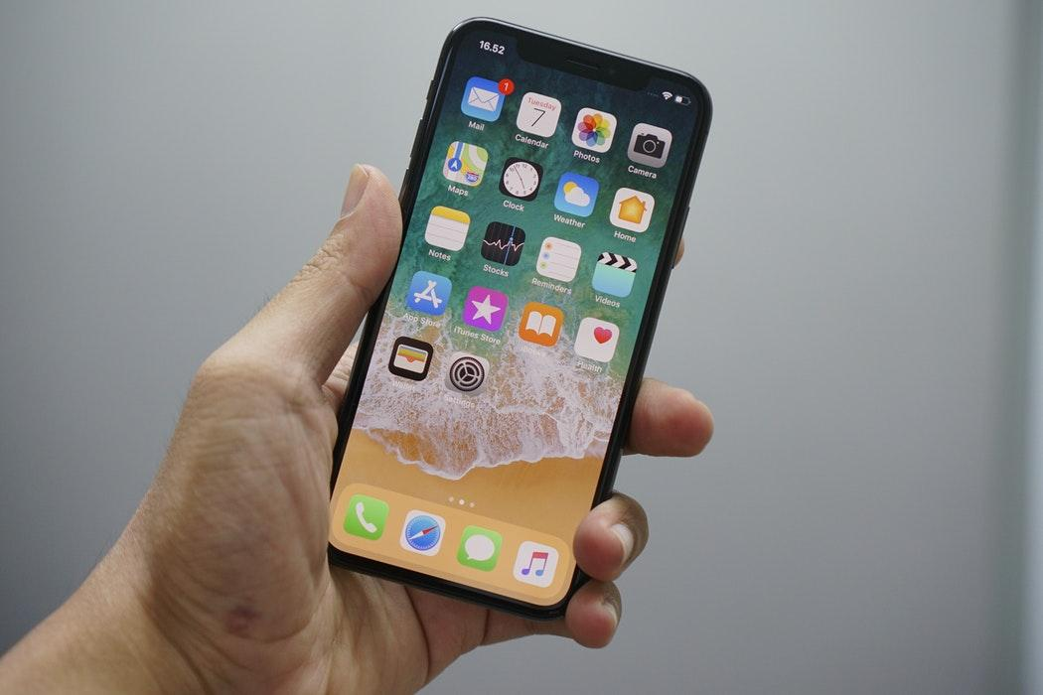
You need to choose your network and approach carefully...

Slide 8

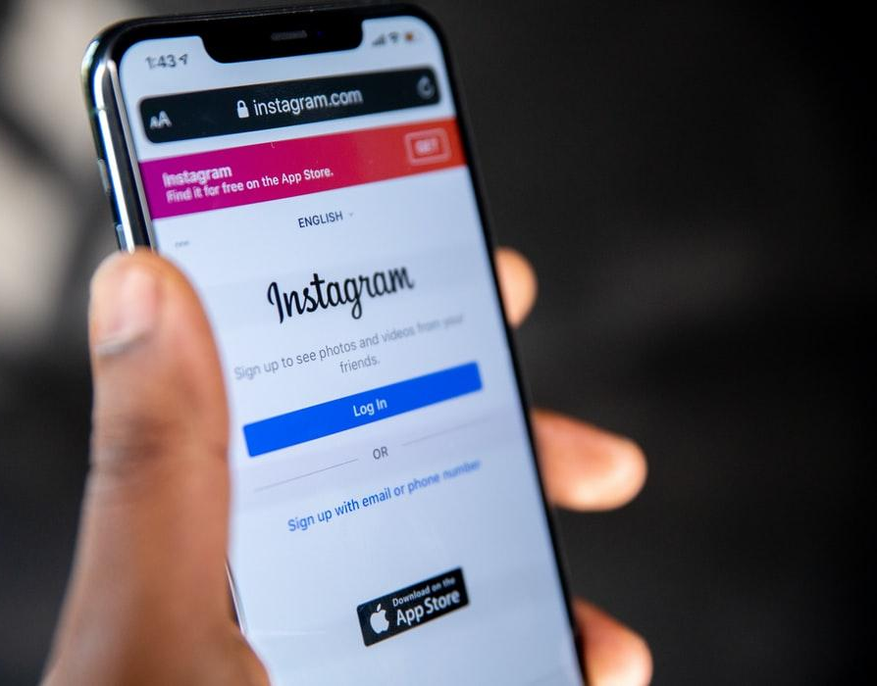

Slide 9


VS

Slide 10

ELEVATOR PITCH
A piece of communication that allows you to introduce yourself, skills, experience and future focus.

Slide 11
PITCH FRAMEWORK
Skills
Future Focus
Who
Experience
Focus on two critical skills that you want the listener to understand.
Sharing your vision and career aspirations
Your name, position and company /school
What abled you to develop these skills?

Slide 12
Example:
My name is Sarah Smith, I’m an ACAP student studying a Bachelor of Counselling and have a passion for mental health, in particular postnatal depression.
I have developed trauma-informed counselling techniques and an understanding of the mental health challenges new mothers face through my involvement with my volunteering at the The Royal Women's Hospital.
I’m currently looking for opportunities to further develop my awareness of this area through an internship or observation hours, as apart of my course.

Slide 13

Learning Activity
Take 5 minutes to develop your own pitch.

Slide 14
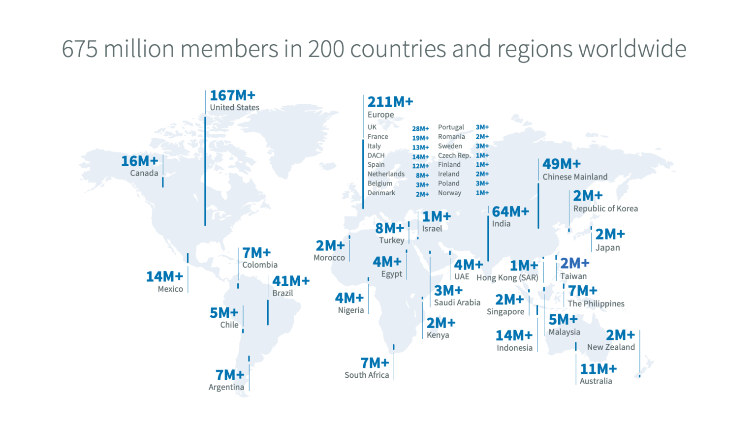
LinkedIn
A social media platform that professionals use to collaborate, hire and build influence amongst industries.

Slide 15
THE NUMBERS
13% of Millennials use LinkedIn
More than 90% recruiters use LinkedIn
Of 500 million users only 3m post weekly
Hosts 10 million active job postings
106 million people access the site monthly
An average user spends 17 minutes per month on LinkedIn.
LinkedIn by the Numbers: Stats, Demographics & Fun Facts Omnicore Agency, Salman Aslam, Jan 6th 2019

Slide 16

Profile Basics

Slide 17
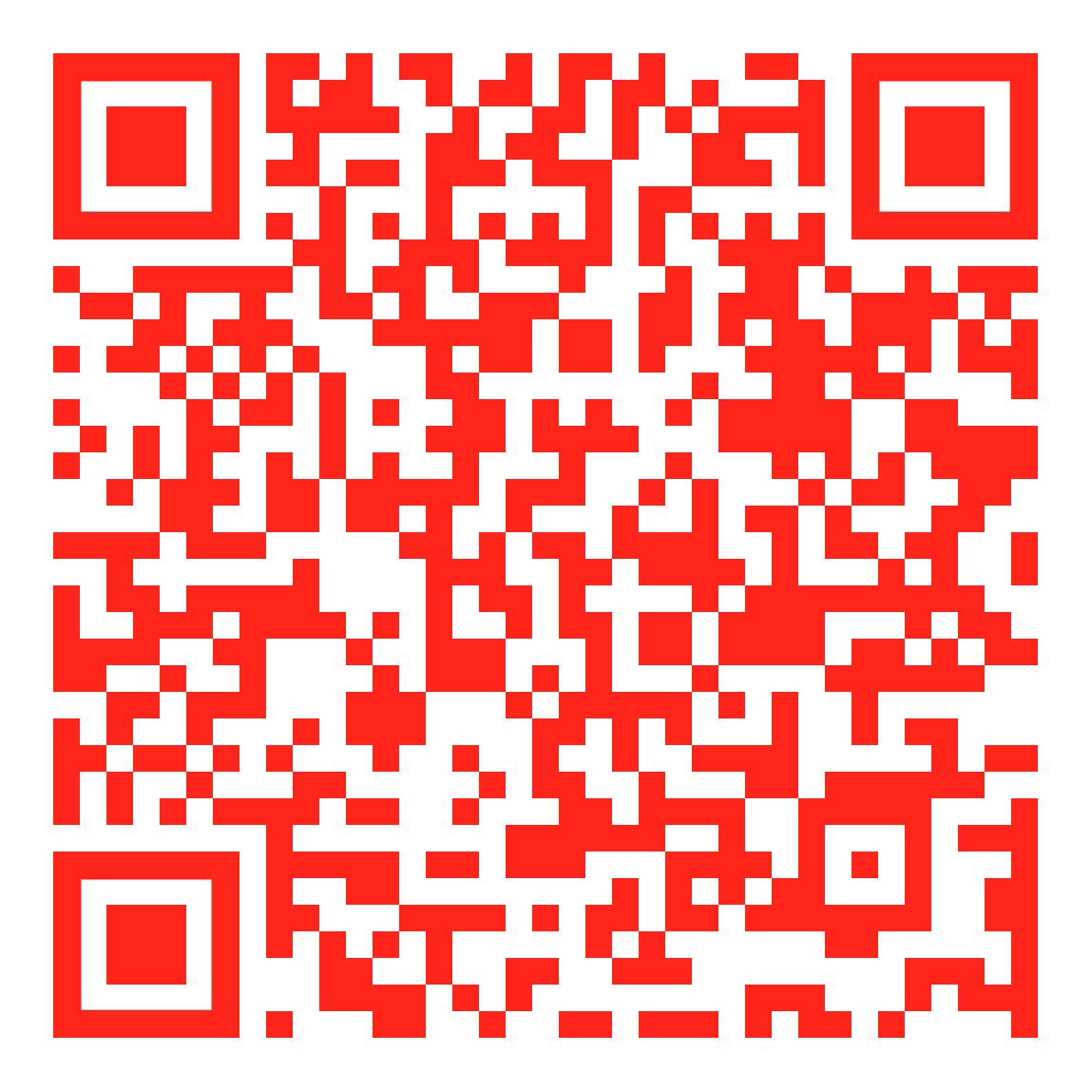
Profile
Need to create a profile? Download the Arrive & Thrive ‘Creating a LinkedIn Profile PDF’ for FREE.
Your 24hr portfolio of work, that can open opportunities across the globe.

Slide 18

Connections
Connection is essential, but it is HOW you connect, which is the most important part.
These individuals will generate your news feed and engagement on the platform.

Slide 19
PURPOSE OF CONNECTIONS FOR STUDENTS
Building your Personal Brand & Reputation
Engagement with Industry
Career Research
A network of Mentors to learn from

Slide 20
RULES ON CONNECTING
HUMAN / AUTHENTIC
PERSONALISE INVITE
FUTURE FOCUS
Be Human
Embrace your personality
Focus on your lived experience
Find the rapport between you and that person
Take the time to focus on their profile
Diversify your network
Pretend you are face to face
Work towards your ideal self
Connect with people who will bring you closer to this
Focus on your next career move
Share your aspirations
Provide Value

Slide 21
Connection using the App
The user interface is different from the desktop.

Slide 22
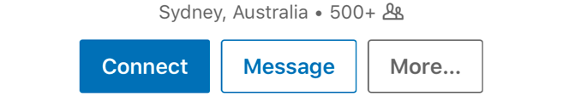
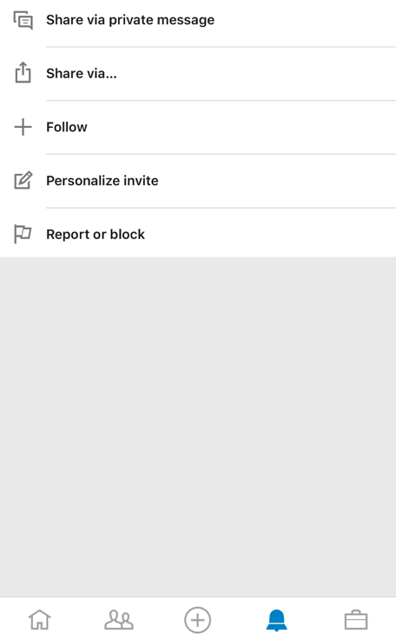
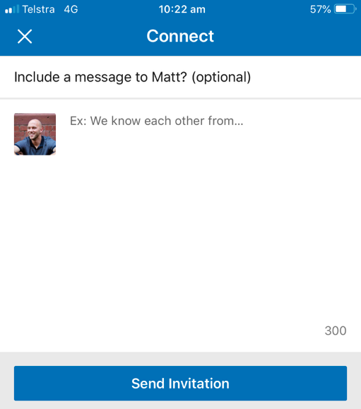
PERSONALISED INVITES
Hi Matt, great to meet you the other day at the virtual conference. I would love to connect and see your updates. Have a great day.

Slide 23
INVITATION TEMPLATES
1
2
3
Hi, my name is Sarah. I’m interested in following your updates and connecting as I would love to gain more of an understanding of your industry as I’m currently exploring opportunities in this space.
Hi, my name is Sarah. We spoke at the industry evening. I enjoyed your presentation and would love to connect and see your updates
Hi, my name is Sarah. I found your recent post engaging and insightful. I would love to connect and see your updates.

Slide 24

Posting & Engaging
This is how you build your personal brand and develop your reputation.
Industry and professional want to hear from students and young people

Slide 25
DOCUMENT
What should I post about?
STUDENT VOICE
How should I engage?
POSTING GOALS
Post about your journey, volunteering, work experience and things you have learnt!
Share your thoughts and share your opinions. Stay authentic and professional.
We recommend jumping on and engaging every second day.

Slide 26

Career Coaching & Counselling
All ACAP students offered 20% of our coaching services.
$225 Session (inclusive of GST)
60 minute session
ACAP Student Rate of $180 (inclusive of GST)

Slide 27
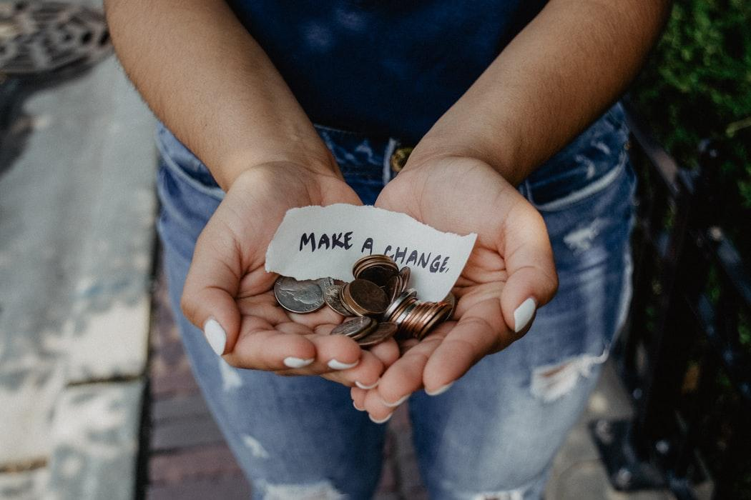



THANKS
Reach out to hello@arrivethrive.com.au
arrivethrive.com.au
Thanks to Slidesgo & Flaticon for slide template and icons.

